Slide 1
Network Layer:
Logical Addressing
(IP Addressing )
Every host / gadget connected to internet,
must have an unique IP address,
19.<number>
Notes:
<number>

Slide 2
Internet
H1
Internet is network of networks
Global internet is divided into hundreds of sub-networks
Each Network or Sub-network is uniquely identified by an address ( Network ID or Subnet ID )
every host connected to internet is part of a sub network.
So , the address of a host has
2 parts
N2
N3
N1
N5
N4
N6
N7
N8
N
H
Subnet ID
Host ID
Notes:
<number>

Slide 3
This host belongs to the sub network N1
Internet
N1
H
Host
N2
Subnet ID
Host ID
N3
N1
N5
N4
This host belongs to the sub network N6
N6
H
Host
N6
N7
N8
Subnet ID
Host ID
Example
If the IP address of a host connected to a sub network is 192.168.1.1/24, its sub net ID is 192.168.1.0 …..how…..details letter
Notes:
<number>

Slide 4
Internet
So, the IP address, depends on the network to which it is connected.
The IP address ,when a client is connected at home is different from when it is connected at college campus.
N2
N3
N1
N5
N4
N6
N7
N8
Notes:
<number>

Slide 5
IPv4 ADDRESSES
An IPv4 address is a 32-bit address that uniquely and universally defines the connection of a device (for example, a computer or a router) to the Internet.
The address space supported by IPv4 is : 2³² or 4,294,967,296.
19.<number>
Notes:
<number>

Slide 6
Ideally, every smart device connected to internet should have an IP address in the following address space
0
1
2
1000
1001
1002
4,294,967,295
Theoretically, from the addressing point of view, this is how it looks like
Host 4,294.967,295
Host 0
Internet
Host 1
Host 111
Host 2001
19.<number>
Notes:
<number>

Slide 7
Since internet is a public network, address space has to be controlled by some authority
Who ?
Internet Corporation for Assigned Names and Numbers (ICANN )
Notes:
<number>

Slide 8
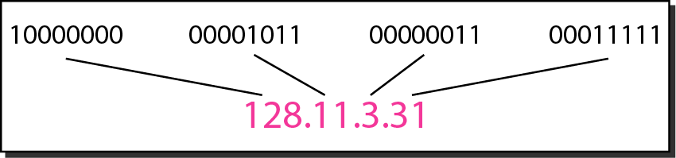
Dotted-decimal notation and binary notation for an IPv4 address
First address
Binary | Equivalent Dotted decimal notation
00000000 00000000 00000000 00000000 | 0.0.0.0
Intermediate address ( Random )
10000000 10000001 10000010 11111111 | 128.129.130.255
Last address
11111111 11111111 11111111 11111111 | 255.255.255.255
19.<number>
Notes:
<number>

Slide 9
Example 19.1
Change the following IPv4 addresses from binary notation to dotted-decimal notation.
Solution
We replace each group of 8 bits with its equivalent decimal number (see Appendix B) and add dots for separation.
19.<number>
Notes:
<number>

Slide 10
Example 19.2
Change the following IPv4 addresses from dotted-decimal notation to binary notation.
Solution
We replace each decimal number with its binary equivalent (see Appendix B).
19.<number>
Notes:
<number>

Slide 11
Example 19.3
Find the error, if any, in the following IPv4 addresses.
Solution
a. There must be no leading zero (045).
b. There can be no more than four numbers.
c. Each number needs to be less than or equal to 255.
d. A mixture of binary notation and dotted-decimal notation is not allowed.
19.<number>
Notes:
<number>

Slide 12
In classful addressing, the address space is divided into five classes:
A, B, C, D, and E.
This was the earlier version of IP address allocation ; Now has become obsolete.
However for learning purpose, knowing this is important
&
to appreciate the improved ( current) version i.e. Classless address
19.<number>
Notes:
<number>

Slide 13
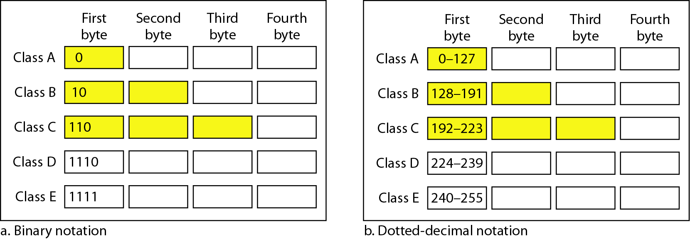
Figure 19.2 Finding the classes in binary and dotted-decimal notation
19.<number>
Notes:
<number>

Slide 14
Number of blocks
and block size in classful IPv4 addressing
19.<number>
Notes:
<number>

Slide 15
Example 19.4
Find the class of each address.
a. 00000001 00001011 00001011 11101111
b. 11000001 10000011 00011011 11111111
c. 14.23.120.8
d. 252.5.15.111
Solution
a. The first bit is 0. This is a class A address.
b. The first 2 bits are 1; the third bit is 0. This is a class C address.
c. The first byte is 14; the class is A.
d. The first byte is 252; the class is E.
19.<number>
Notes:
<number>

Slide 16
Concept of Network Mask or Subnet Mask
Whenever a host connected to internet is to be identified or configured, 2 numbers are used
IP Address
Network mask or subnet mask
Table 19.2 Default masks for classful addressing
Network mask or subnet mask is used to find out the network id or subnet id to which a host belongs to.
19.<number>
Notes:
<number>

Slide 17
Disadvantage of traditional Classfull addressing
In classfull addressing, a large part of the available addresses were wasted.
Why ?
“ find out the answer “
19.<number>
Notes:
<number>

Slide 18
Classless
( also called Classless Internet Domain Routing –CIDR )
address mechanism is used in modern internet
In Classless addressing,
required block of addresses for a subnet can be allocated,
in order to
efficiently use the address space..
19.<number>
Notes:
<number>

Slide 19
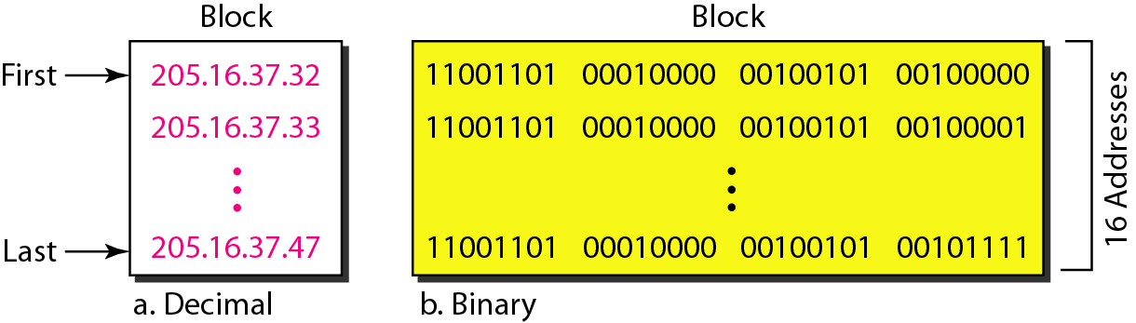
Classless address Concept
Example : A block of 16 addresses granted to a small organization
19.<number>
Notes:
<number>

Slide 20

Note
In IPv4 classless addressing, a block of addresses can be defined as
x.y.z.t /n
in which x.y.z.t defines one of the addresses and the /n defines the mask.
19.<number>
Notes:
<number>

Slide 21
Any sub network is characterized by the following 4 parameters :
Subnet ID
Total number of addresses in that subnet / block
( Address space )
3. First usable address
4.Last usable address
Notes:
<number>

Slide 22
x.y.z.t /n
Note
The number of addresses in the block can be found by using the formula 2^{32−n}.
19.<number>
Notes:
<number>

Slide 23
Example 19.8
Find the number of addresses in Example 19.6.
Solution
The value of n is 28, which means that number of addresses is 2 ³²⁻²⁸ or 16.
19.<number>
Notes:
<number>

Slide 24
x.y.z.t /n
The first address in the block can be found by setting the rightmost 32 − n bits to 0s.
19.<number>
Notes:
<number>

Slide 25
Example 19.6
A block of addresses is granted to a small organization. We know that one of the addresses is 205.16.37.39/28. What is the first address in the block?
Solution
The binary representation of the given address is
11001101 00010000 00100101 00100111
If we set 32−28 rightmost bits to 0, we get
11001101 00010000 00100101 0010000
or 205.16.37.32.
19.<number>
Notes:
<number>

Slide 26
x.y.z.t /n
Note
The last address in the block can be found by setting the rightmost 32 − n bits to 1s.
19.<number>
Notes:
<number>

Slide 27
Example 19.7
Find the last address for the block in Example 19.6.
Solution
The binary representation of the given address is
11001101 00010000 00100101 00100111
If we set 32 − 28 rightmost bits to 1, we get
11001101 00010000 00100101 00101111
or
205.16.37.47
This is actually the block shown in Figure 19.3.
19.<number>
Notes:
<number>

Slide 28
‘Rules’ of IP addressing
The first address in a block /subnet is normally not assigned to any device in the subnet; it is used as the subnet ID that represents the complete subnet to the rest of the world.
The Last address in a block is normally not assigned to any device; it is used as a special address to broadcast a packet to all the hosts in that subnet
So, total number of usable addresses in a subnet is always total number of addresses available – 2
For example in a clasfull addressing, in class C, only 254 addresses can be used to configure hosts.
19.<number>
Notes:
<number>

Slide 29
Each address in the block can be considered as a two-level hierarchical structure: the leftmost n bits (prefix) define the network;
the rightmost 32 − n bits define the host.
19.<number>
Notes:
<number>

Slide 30
Role of subnet mask in IP address
Every IP address assigned to a host must be accompanied by another parameter called Subnet Mask
Example
IP address : 10. 20. 30. 4
Subnet mask : 255.255.255.0
When subnet mask is ANDed with IP address
following number is resulted:
10.20.30.0
Which is the subnet ID to which the respective host belongs to
Prefix
Notes:
<number>

Slide 31
Combination of IP address and Subnet mask can also be represented in following notation :
x.y.z.t /n
IP address : 10. 20. 30. 4
Subnet mask : 255.255.255.0
is also represented as
10.20.30.4/24
Why 24 ?
Number of 1s in the subnet mask
Prefix
Notes:
<number>

Slide 32
One more example
IP address : 10. 20. 30. 4
Subnet mask : 255. 255. 0. 0
Prefix
Subnet ID : 10.20.0.0
Notes:
<number>

Slide 33
x.y.z.t /n notation
IP address : 10. 20. 30. 4
Subnet mask : 255. 255. 0. 0
Is equivalent to
10.20.30.4/16
Why 16
Number of 1s in the subnet mask is 16
Prefix
Notes:
<number>

Slide 34
summary
Purpose of
Subnet mask ( or /prefix number )
is
to find out
to which subnet
the respective host belongs to
Notes:
<number>

Slide 35
10.10.10.1/24
H1 , H2 & H3 belong to one subnet because subnet id of each of these addresses is 10.10.10.0
H1
10.10.10.2/24
H2
10.10.10.254/24
H3
Notes:
<number>

Slide 36
Two or more subnets can be networked only using Routers not using Switch or Hub
Subnet #1
10.10.10.0/24
Router
Subnet #2
20.20.20.0/24
Subnet #3
30.30.30.0/24
Notes:
<number>

Slide 37
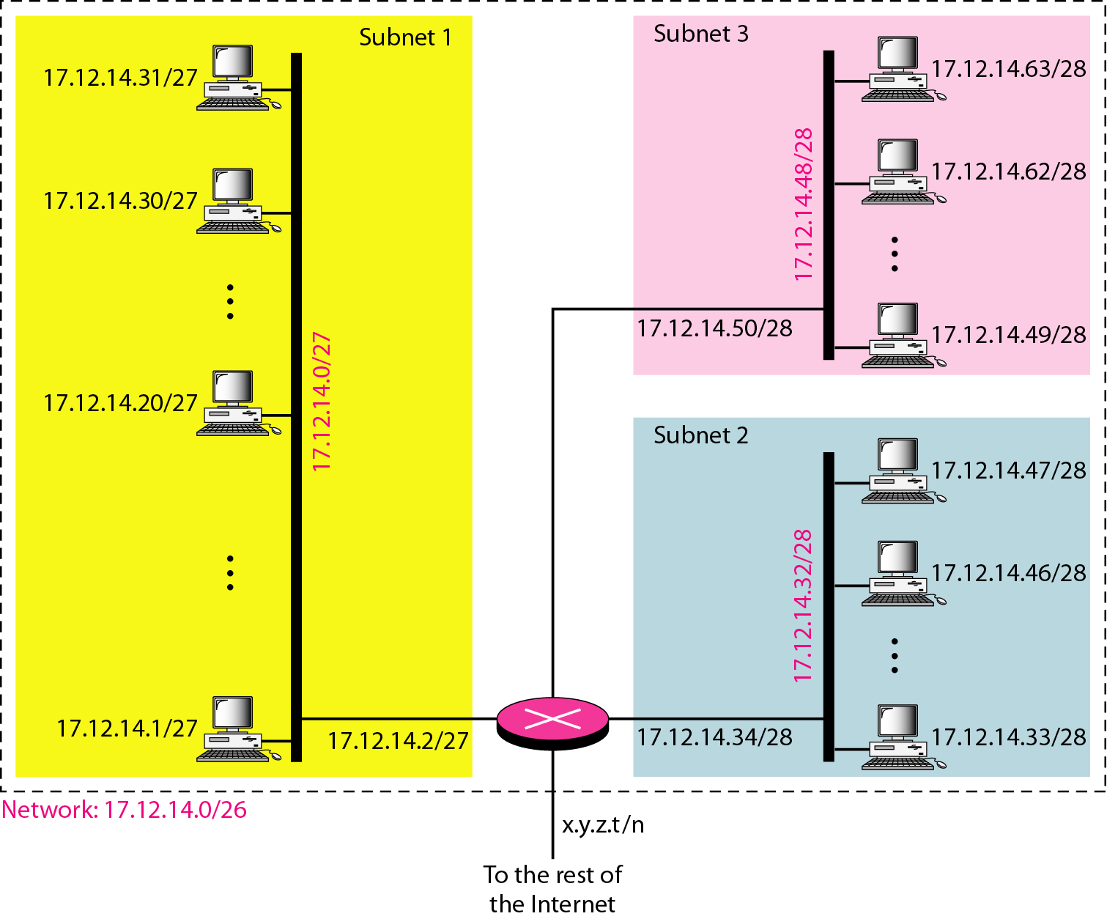
Example :
An network address space 17.12.14.0/26 is segmented in to 3 subnets
Pay attention n to the suffix and prefix in the IP addreses
19.<number>
Notes:
<number>

Slide 38
???
IPV4 addressing - Major challenge for the technologists :
Only 4 billion addresses are available ; But number of hosts/gadgets to be connected is more than 4 billion.
Because of mobile revolution, users are exponentially growing.
How to manage the demand and supply problem
???
Demand ( for more IP addresses )
Supply problem ( limited IP addresses )
Notes:
<number>

Slide 39
How to provide address for growing number of users ?
Temporary ( Ad-hoc solutions)
Permanent Solution
1.Classless Addressing
IPV6
2. DHCP
3.NAT
Notes:
<number>

